Slide 1


Slide 2

Vishwaniketan’s
Institute of Management Entrepreneurship & Engineering Technology
Computer Science & Engineering (AI & ML) Department
Major Project Presentation
ON
“ConnectEdAI”
BY
Mr. Yash Chorghe 09
Mr. Abhinandan Mokal 31
Mr. Shubham Mokal 32
Mr. Atharv Patil 40
Under Guidance of
Dr. Ankush Pawar

Slide 3
OUTLINE
1. Introduction and Motivation
2. Research Objectives and Scope
3. Problem Statement
4. Literature Review
5. Research Gaps
6. Proposed System
7. Requirement Analysis
8. Design and Planning
9. Result and Discussion
10. Conclusion
11. Future Scope
12. References

Slide 4
Introduction
ConnectEd-AI revolutionizes student support by leveraging AI for personalized learning paths.
With ConnectEd-AI, students access tailored study plans and guidance for academic success.
ConnectEd-AI merges educational expertise with cutting-edge technology to enhance student performance.
Experience the future of education with ConnectEd-AI's intuitive platform for exam preparation.
ConnectEd-AI empowers students to excel academically through AI-driven learning solutions.

Slide 5
Motivation
The motivation behind the development of ConnectEd-AI stems from a profound desire to enhance educational outcomes and support students in their academic endeavors.
As technology continues to advance, there is a growing need for innovative solutions that can personalize learning experiences and address individual student needs.
ConnectEd-AI aims to bridge the gap between traditional education and cutting-edge AI technologies, empowering students to achieve their full potential.

Slide 6
Research Objectives
Aim to identify key areas where AI can enhance educational experiences for students of all levels.
Aim to explore the potential of AI-driven personalized learning platforms in improving student engagement and academic performance.
Aim to investigate the efficacy of AI algorithms in analyzing student data to provide tailored recommendations and support.
Aim to develop practical strategies for integrating AI technologies into existing educational frameworks.
Aim to assess the impact of AI-powered educational platforms on student learning outcomes and overall educational quality.

Slide 7
Problem Statement
Limited personalized support: Many students struggle to receive personalized guidance and support tailored to their individual learning needs within traditional educational settings.
Lack of adaptive learning resources: Existing educational resources often lack adaptability, failing to adjust to students' changing learning styles and preferences.
Difficulty in tracking progress: Students and educators face challenges in effectively monitoring student progress and identifying areas for improvement in real-time.
Inefficient use of technology: Despite advancements in educational technology, there is a gap in leveraging AI-driven solutions to optimize learning experiences and outcomes for students.

Slide 8
Scope of Proposed Research
To devise an efficient system for student performance enhancement, integrating AI and ML for tailored educational support and real-time feedback.
To create a scalable educational platform, catering to diverse learning needs, facilitating student engagement, and promoting academic success.
To explore the potential of AI technologies in revolutionizing education, fostering a dynamic learning environment, and empowering students to achieve their academic goals.

Slide 9
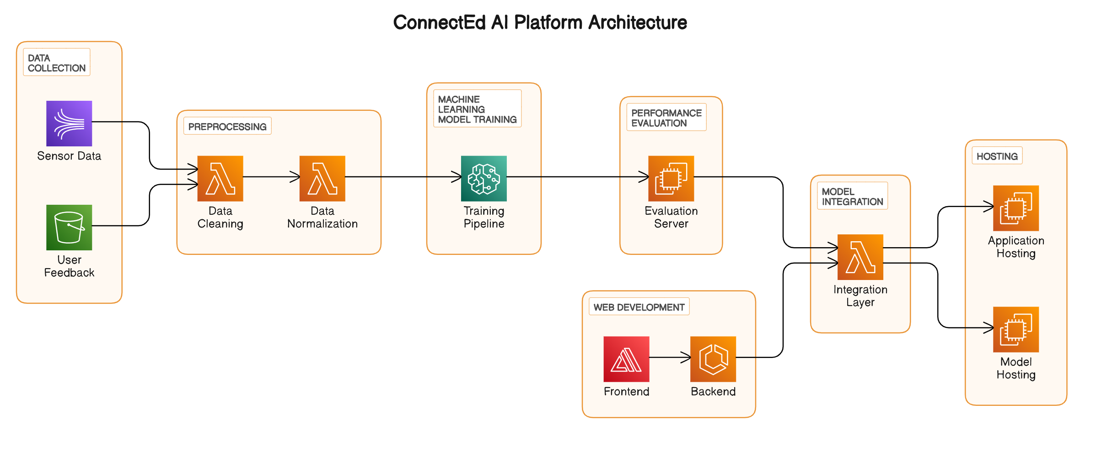
Proposed System

Slide 10
Literature Review

Slide 11
Literature Review on Privacy in Communication
Sr. No | Authors Name | Objective | Method | Research Gap
1 | Lan Q. | Foster personalized teaching and student growth. Enhance educator-student interaction for holistic development. | The role of big data and artificial intelligence is emphasized in enabling individualized teaching, management, and learning for college students, with a focus on personalized guidance, feedback, and interaction within the educational process | For enhancing security further techniques needs to be explored and more metrics need to be used for performance validation.
2 | González-Calatayud, V., Prendes-Espinosa, P., & Roig-Vila, R. | Assess the current state of AI applications in educational assessment. Identify the need for teacher training and future research directions. | Formative evaluation and automatic grading are identified as the primary uses of AI in assessment. | There is limited research on the cost-effectiveness of implementing and maintaining AIbased personalized e-learning systems, which represents a potential research gap

Slide 12
Literature Review on Privacy in Communication
Sr. No | Authors Name | Objective | Method | Research Gap
3 | Bajaj, R., & Sharma, V | Develop a framework for adaptive education using AI and diverse learning models. Enable scalable, cloud based, personalized learning for students. | The framework not only identifies comprehensive set of student learning attributes but also offers a systematic approach for selecting appropriate learning theory models and artificial intelligence methods. | Research may not sufficiently explore how personalized e-learning systems
4 | Murtaza, M., Ahmed, Y., Shamsi, J. A., Sherwani, F., & Usman, M. | Create an integrated AIdriven e-learning system for personalized content delivery. Address challenges, recommend solutions, and outline future research directions.. | It points out that while there has been significant research on e-learning personalization, many existing AI-based techniques are not integrated into a comprehensive framework. | Research often emphasizes short-term outcomes, creating a research gap related to understanding the long-term effects of personalized e-learning on knowledge retention, skill development, and career success

Slide 13
Gap analysis
Many studies focus on specific implementations or case studies, leaving a research gap in exploring how AI-driven personalized e-learning systems can be effectively scaled up to accommodate a broader range of learners and subjects.
Research often emphasizes short-term outcomes, creating a research gap related to understanding the long-term effects of personalized e-learning on knowledge retention, skill development, and career success.
A common research gap exists in understanding how learners perceive and engage with AIdriven personalized systems over time, including issues related to user acceptance, motivation, and potential fatigue.
Ethical implications of personalized e-learning, such as data privacy, algorithmic bias, and the potential for reinforcing educational inequalities, are often not adequately addressed in research.

Slide 14
PROPOSED SYSTEM

Slide 15
Problem Statement
1. The proposed system for ConnectEd-AI integrates data collection, preprocessing, model training, and web development modules.
2. It aims to streamline the process of gathering student data, extracting relevant features from syllabi, and training machine learning models.
3. The system leverages NLP techniques to extract important topics from syllabus documents and optimize model performance.
4. Additionally, it facilitates seamless integration of the trained model with a web interface for user interaction.
5. Overall, the proposed system offers a comprehensive solution to enhance educational support and performance evaluation for students.

Slide 16
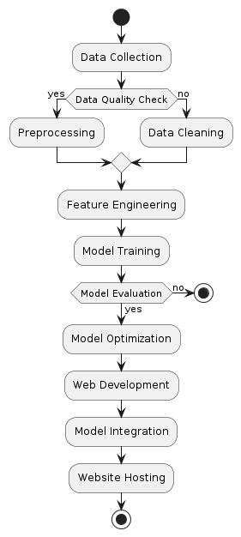
Workflow Diagram:

Slide 17
Requirement Analysis
Software:
Web Server
Machine Learning and Deep Learning Libraries
Natural Language Processing (NLP) Tools
Web Development Frameworks
Machine Learning Integration

Slide 18
Requirement Analysis
Hardware:
Processor
Memory (RAM)
Storage (HDD)

Slide 19
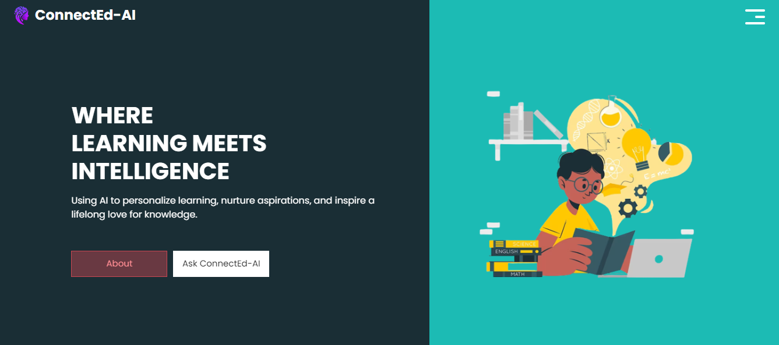
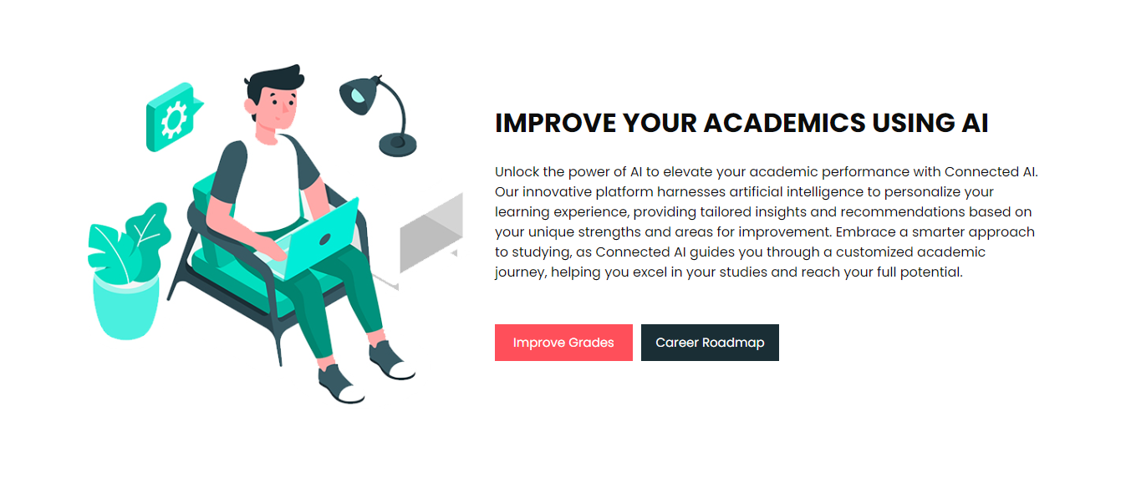
Implementation and Result Discussion

Slide 20
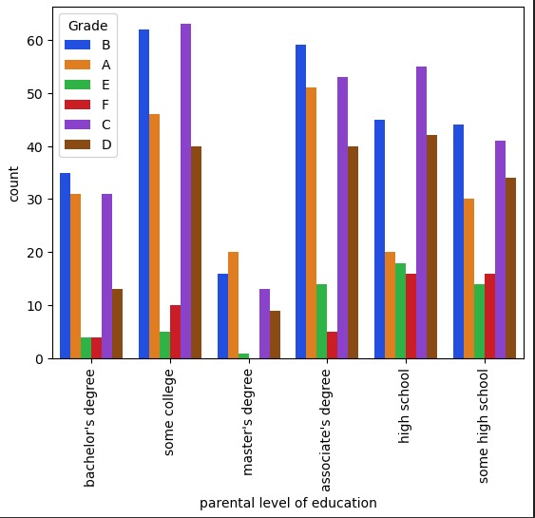
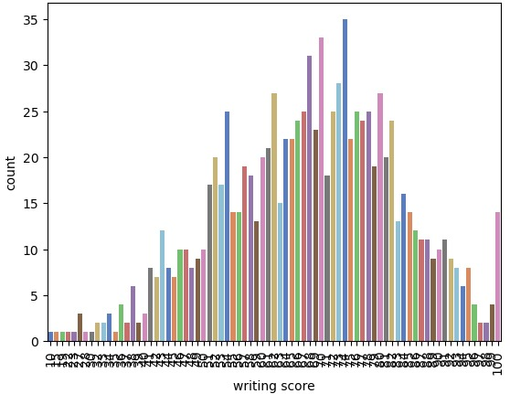
Data Analysis

Slide 21
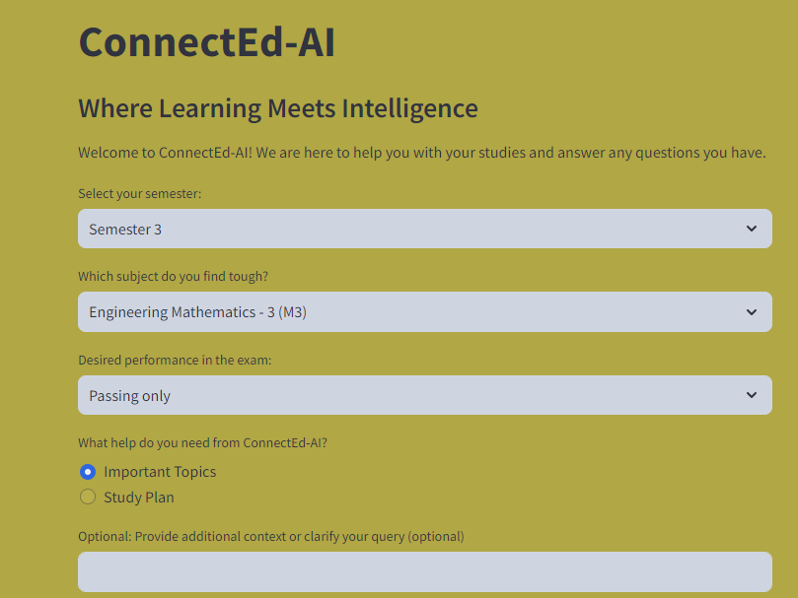
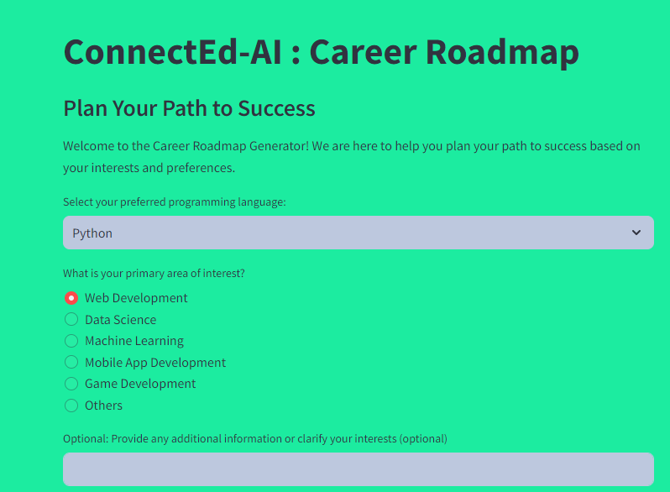
Result

Slide 22

Conclusion and Future Work
In conclusion, ConnectEd-AI offers a comprehensive solution to enhance students' educational journey through AI-driven guidance.
As we move forward, continuous improvement and innovation are essential to address evolving educational needs.
Future endeavors will focus on expanding the platform's capabilities and incorporating advanced AI technologies to provide even more personalized and effective support to students.

Slide 23
References
Lan, Q. (2021, February). Construction of personalized education model for college students driven by big data and artificial intelligence. In Journal of Physics: Conference Series (Vol. 1744, No. 3, p. 032022). IOP Publishing.
González-Calatayud, V., Prendes-Espinosa, P., & Roig-Vila, R. (2021). Artificial intelligence for student assessment: A systematic review. Applied Sciences, 11(12), 5467.
Zhang, Y., Qin, G., Cheng, L., Marimuthu, K., & Kumar, B. S. (2021). Interactive Smart Educational System Using AI for Students in the Higher E
Murtaza, M., Ahmed, Y., Shamsi, J. A., Sherwani, F., & Usman, M. (2022). AI-based personalized e-learning systems: Issues, challenges, and solutions. IEEE Access.

Slide 24
Thank You !!

